Slide 1

Media Mix Model
Presented by Biyi Olaibi

Slide 2
Task A
Build a Media-Mix Model (MMM) to explain the relation between media spend and revenue.
Identify the channel's performance and provide recommendations on where to increase or decrease marketing investment.

Slide 3
Media Mix Model Selection
Model Type | Multiple Linear Regression | Bayesian Model (Lightweight MMM)
Advantages | Relatively simple, results are intuitive and highly interpretable, serves as a strong baseline model, low computational cost. | Ability to incorporate prior knowledge into the model through prior distribution. Two key marketing principles included in model: 1) Saturation - effect decay as expenditure increases. 2) Adstock - effect on sales may lag behind initial exposure and extend several weeks. Flexible - incorporate complex interactions. Inherent regularisation to prevent overfitting.
Disadvantages | Different from reality, assumes linearity, sensitive to multicollinearity, fails to capture complex interactions, negative coefficients contradict expectations and can lead to misleading insights. | Sensitive to prior, more complex and high computational cost. Requires expert/domain knowledge
Model Validation (On Test Dataset) | R-Squared = 19.15% Mean Absolute Percentage Error = 4.42% | R-Squared = 29.3% Mean Absolute Percentage Error = 5.28%
Model Selection Reason |  | Better results compared to Multiple Linear Regression Closer to actual marketing scenario. Positive media channel coefficients

Slide 4
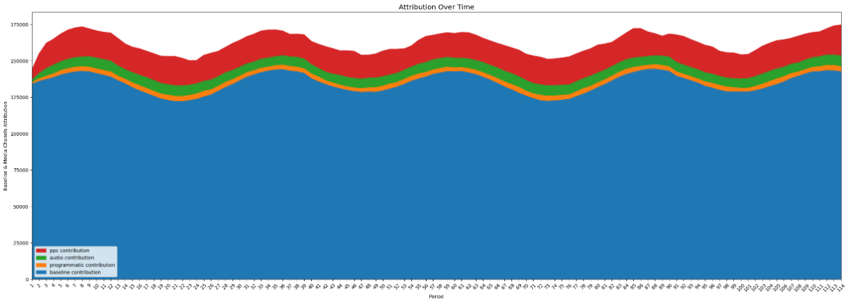
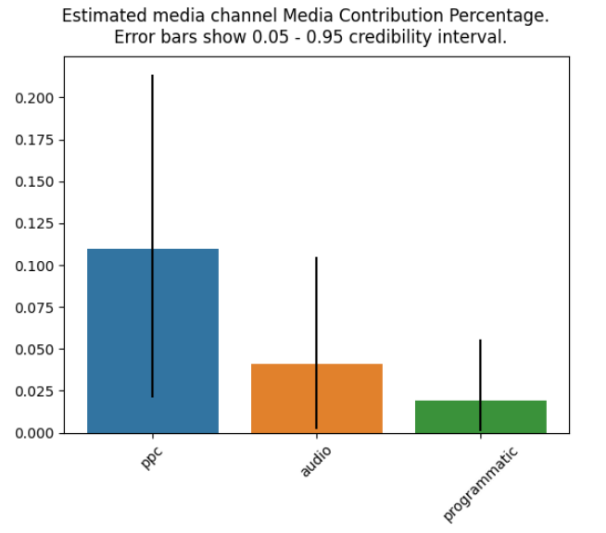
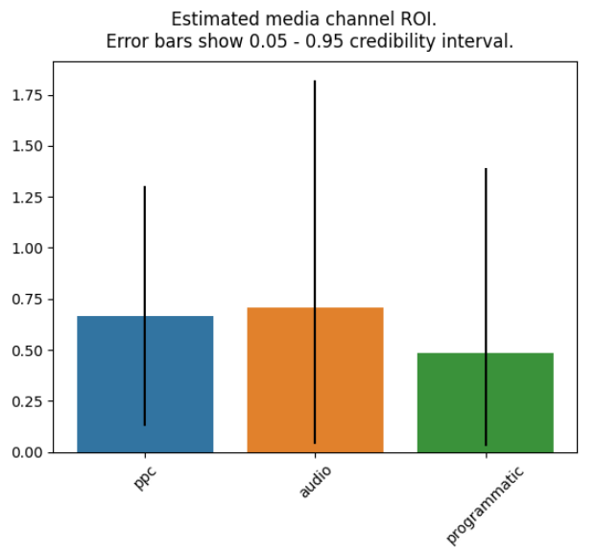
Media Channel Contribution
Component | Driver | Coefficient
Incremental Sales | PPC | 0.11
 | Audio | 0.4
 | Programmatic | 0.2
Control Factor Sales | *Price | -0.23
*The negative sign of the price coefficient indicates the amount of revenue lost due to increase in price.
PPC has a higher contribution percentage however Audio has a slightly better ROI.

Slide 5
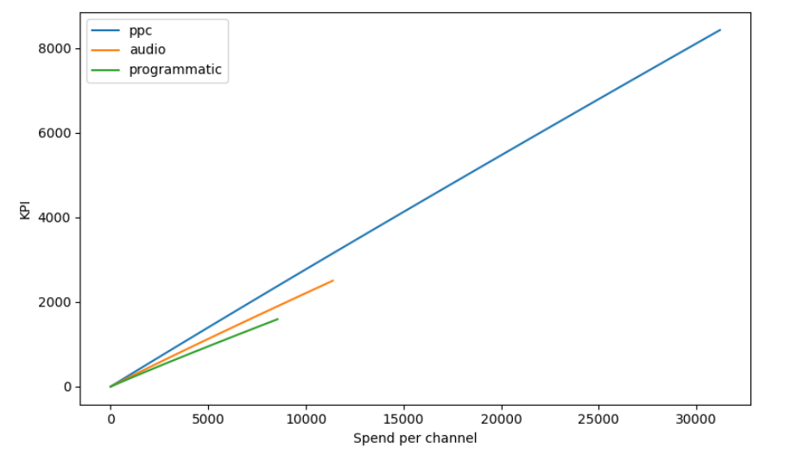
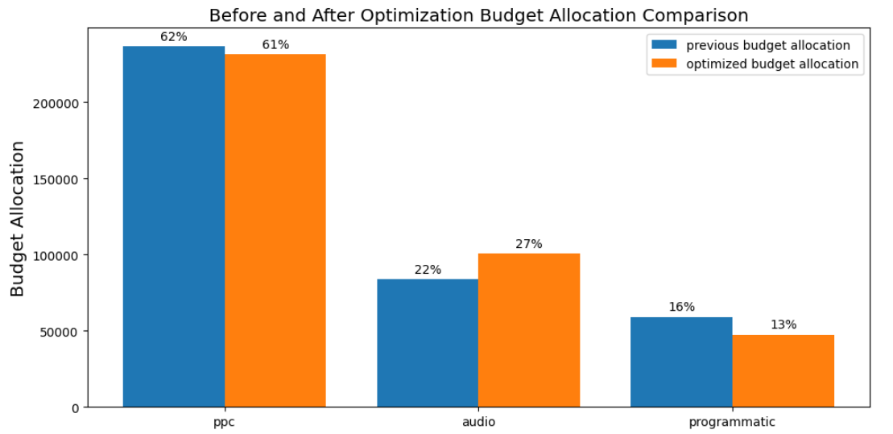
Marketing Budget Recommendation
Response Curve
Expected Revenue
The response curve shows the expected revenue (KPI) to expect for a given spend per media channels.
PPC drives the most revenue, followed by audio and lastly programmatic.
Recommendation
Optimised budget allocation -
PPC: 61%
Audio: 27%
Programmatic: 13%
Given PPC channel drives the most revenue - the optimiser has suggested keeping the spend contribution high, however implement a 1% reduction in spend.
Given Programmatic channel drives the least revenue - the optimiser has suggested a 3% reduction in spend
Given Audio channel generates the best ROI - the optimiser has suggested a 5% increase in spend.

Slide 6
Task B
The client is eager to run an experimentation campaign to validate and build confidence in
your model.
To this purpose, please develop a high level design for an initial test aimed at
gathering additional insight and/or validating some of your findings. When designing the
experiment, you can assume control of media delivery at any geographic level, and that the client
can also provide sales data at the geo granularity.

Slide 7
High Level Experimental Design
Objective
The primary goal is to validate the media mix model findings by testing the impact of PPC, audio, and programmatic channels on revenue and ROI in a controlled environment..
1. Geographic Segmentation
I will select Test and Control geo regions, ensuring regions are large enough to detect meaningful differences in KPI like revenue (sufficient sample size with statistical power), but small enough to minimise external differences, such as competitor activities or cultural difference.
Test Region - Select a few geographically diverse regions where I will manipulate the media spend on PPC, Audio and Programmatic channels
Control Region - Select similar regions (in terms of revenue, sales, demographics, sales history and market conditions) where media spend will remain unchanged during the experiment.
2. Media Spend Allocation
Keep media spend consistent in the control regions to serve as a baseline for comparison.
PPC:
Increase spend in one set of test regions to observe changes in Revenue and ROI.
Decrease spend in another set of test regions to assess how Revenue and ROI are impacted.
Audio:
Allocate additional budget to Audio in a different set of test regions to validate the ROI finding in Task A.
Test a decrease in Audio spend in a separate set of regions.
Programmatic:
Slightly adjust spend to observe its relative contribution compared to PPC and Audio
5. Data Collection
Revenue Data:
Collect revenue data at the same geo granularity as the media spend
Media Spend Data:
Track the actual media spend for PPC, Audio and Programmatic in each geo region.
Other Factors:
Monitor other relevant factors that might influence revenue (e.g. promotions, competitor activity etc)
4. Metrics to Monitor
Revenue:
Measure revenue generated in each region and compare test regions to control regions.
ROI:
Calculate ROI for each channel (revenue/media spend)
Contribution to Total Sales:
Evaluate the contribution of each media channel to total sales in the test region
Lift Analysis:
Measure incremental lift in revenue attributable to changes in media spend, comparing lift with model predictions in Task A
3. Duration of the Experiment
Run experiment for a about 1-2 months to capture sufficient data, accounting for lag effects in media channels and to smooth out any short term fluctuations
6. Analysis
Comparison with Control Group:
Compare revenue and ROI in test regions with those in control group to isolate effect of media spend changes.
Validation of Model Findings:
Review observed changes in revenue and ROI to determine if they align with the MMM model in Task A.
7. Report and Recommendations
Insights:
Present findings to client, highlighting whether the experiment supports or challenges the models predictions
Next Step:
Based on the results, recommend adjustments to the media mix strategy or suggest further experiments to refine the model.

Slide 8
Appendix A

Slide 9
Glossary
Term | Meaning
Multicollinearity | Occurs when two or more independent variables are highly correlated, making it difficult to determine their individual effects on revenue
Regularisation | Technique used in machine learning to prevent overfitting by adding a penalty to the model's complexity.
R-Squared | Statistical measure to show how much of the variation in revenue can be explained by the model's predictors.
Mean Absolute Percentage Error | Average percent revenue prediction was incorrect for any given week.

Slide 10
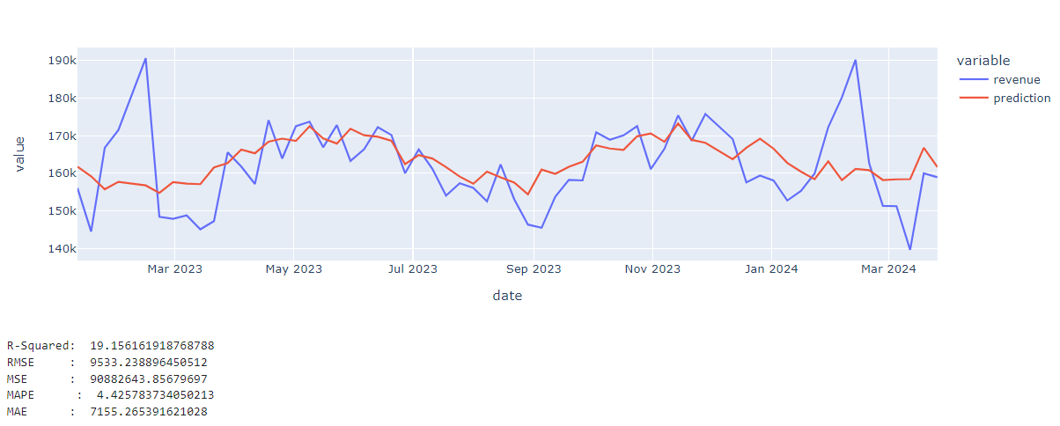
Multiple Linear Regression - Predicted Vs Actual (Test Dataset)

Slide 11
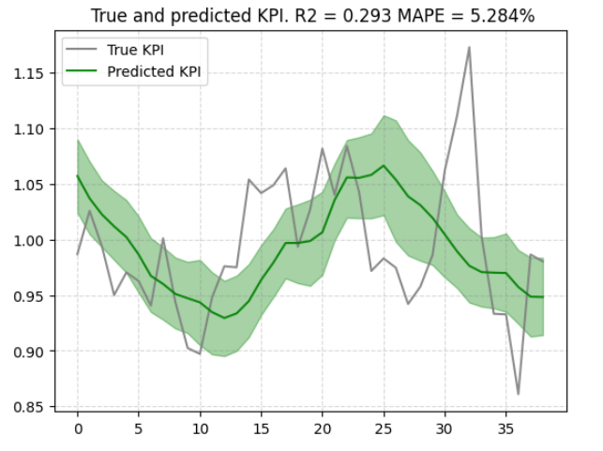
Bayesian Model (Lightweight MMM) - Predicted Vs Actual

